Slide 1


PPARα Activation by N-Palmitoyl ethanolamine Enables Glucocorticoid Dose Reduction in Experimental Arthritis
Supervised By:
Associate. Prof Ahmed abo-elfotoh Morad
Associate. Prof Ahmed Gafaar Gafaar
Associate. Prof Ahmed Saad Saad
By: T.A Riffat Ibrahim Riffat

Slide 2
Rheumatoid arthritis (RA) is a debilitating chronic inflammatory autoimmune disease that affects approximately 1% of the global population.
Its hallmark is a symmetrical polyarthritis, predominantly affecting the small joints of the hands and feet.
Introduction

Slide 3
The pathophysiology involves a complex interplay of genetic and environmental factors that trigger a dysregulated immune response. that leads to synovial inflammation (synovitis), proliferation of the synovial lining (pannus formation), and subsequent erosion of cartilage and bone.
Introduction

Slide 4
Importantly, RA is a systemic condition, often presenting with extra-articular features such as fatigue, rheumatoid nodules, and an increased risk of cardiovascular and pulmonary diseases
The significant morbidity and socioeconomic burden associated with RA underscore the importance of early diagnosis and aggressive treatment to induce remission or low disease activity, thereby preserving joint integrity and patient function.
Introduction

Slide 5
Treatment of R.A
Conventional Synthetic DMARDs (csDMARDs) | First-line disease-modifying therapy | Methotrexate
Antimalarials (csDMARD) | Mild RA; used in combination therapy | Hydroxychloroquine
Immunosuppressants (csDMARD) | Alternative to MTX; slows disease progression | Leflunomide

Slide 6
Treatment of R.A
TNF-α Inhibitors (Biologic DMARDs) | Target cytokines to reduce inflammation | Etanercept
IL-6 Inhibitors (Biologic DMARDs) | Reduce systemic inflammation | Tocilizumab
T-cell Co-stimulation Modulator (Biologic) | Blocks T-cell activation | Abatacept

Slide 7
Treatment of R.A
B-cell Depleting Agent (Biologic) | Reduces autoantibody production | Rituximab
JAK Inhibitors (Targeted Synthetic DMARDs) | Oral targeted therapy; reduces cytokine activity | Tofacitinib

Slide 8
Treatment of R.A
NSAIDs | Symptomatic relief of pain & inflammation (no effect on disease progression) | Ibuprofen
Corticosteroids | Rapid control of acute inflammation; bridge therapy | Prednisolone

Slide 9
Glucocorticoids are potent anti-inflammatory and immunosuppressive agents that play several critical, but typically temporary, roles in RA management:
"Bridge" Therapy: This is their primary role. When a patient is started on a slow-acting DMARD (like methotrexate), which can take weeks or months to become fully effective.
Glucocorticoids provide rapid relief from pain, swelling, and stiffness. They "bridge" the patient until the DMARD starts working.
The role of Glucocorticoids in RA

Slide 10
Glucocorticoids are highly effective for managing rheumatoid arthritis (RA), capable of providing long-term low-dose maintenance for severe cases and even slowing joint damage at higher doses, like DMARDs.
However, due to a wide range of serious, dose-dependent side effects (like metabolic and cardiovascular complications), their use is strictly limited to the lowest possible dose for the shortest possible duration.
The role of Glucocorticoids in RA

Slide 11
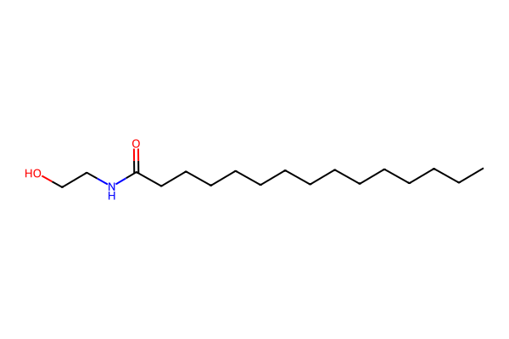
N-Palmitoylethanolamine (PEA) is an endogenous lipid mediator, chemically composed of palmitic acid and ethanolamine, which is naturally produced within the human body and found in dietary sources such as egg yolks, soybeans, and peanuts.
What is PEA
Wang Y, Duan X, Li Z, Pan Y, Deng J. Palmitoylethanolamide in the Treatment of Pain and Its Clinical Application Prospects. Drug Des Devel Ther. 2025;19:6897-6923.

Slide 12

PEA is a promising nutraceutical because it is both effective (with anti-inflammatory, analgesic, and neuroprotective actions) and very safe, even for vulnerable populations.
This excellent safety profile makes it ideal not just as a standalone treatment, but also as an adjunct therapy. When used in combination, PEA can lower the required dose of stronger drugs like NSAIDs and opioids, thereby reducing their side effects.
What is PEA
Wang Y, Duan X, Li Z, Pan Y, Deng J. Palmitoylethanolamide in the Treatment of Pain and Its Clinical Application Prospects. Drug Des Devel Ther. 2025;19:6897-6923.

Slide 13
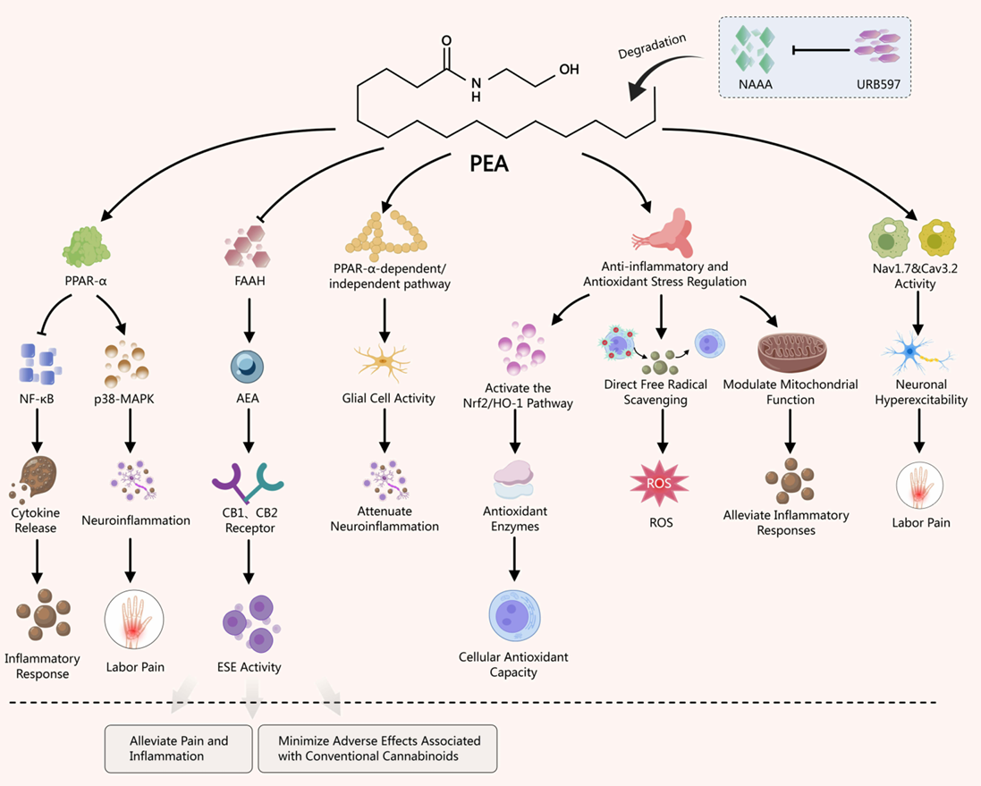
Wang Y, Duan X, Li Z, Pan Y, Deng J. Palmitoylethanolamide in the Treatment of Pain and Its Clinical Application Prospects. Drug Des Devel Ther. 2025;19:6897-6923.

Slide 14
While PEA exerts its anti-inflammatory effects through multiple modes of action, its primary mechanism involves the activation of PPAR-α.
This activation regulates key signaling pathways, leading to the inhibition of both NF-κB and p38-MAPK, which collectively reduce pro-inflammatory factors and modulate inflammation.
PEA as an Anti-inflammatory
Wang Y, Duan X, Li Z, Pan Y, Deng J. Palmitoylethanolamide in the Treatment of Pain and Its Clinical Application Prospects. Drug Des Devel Ther. 2025;19:6897-6923.

Slide 15
The specificity of the NF-κB inhibition occurs through a novel transcriptional mechanism independent of classical PPAR Response Elements (PPREs).
Instead, in a ligand-dependent manner, PPAR-α potentiates the ability of the NF-κB subunit p65 to activate the promoter for IκBα, the natural inhibitor of NF-κB. Thus, PPAR-α reduces inflammation by indirectly boosting IκBα expression, thereby suppressing NF-κB activity.
PEA as an Anti-inflammatory
Wang Y, Duan X, Li Z, Pan Y, Deng J. Palmitoylethanolamide in the Treatment of Pain and Its Clinical Application Prospects. Drug Des Devel Ther. 2025;19:6897-6923.

Slide 16
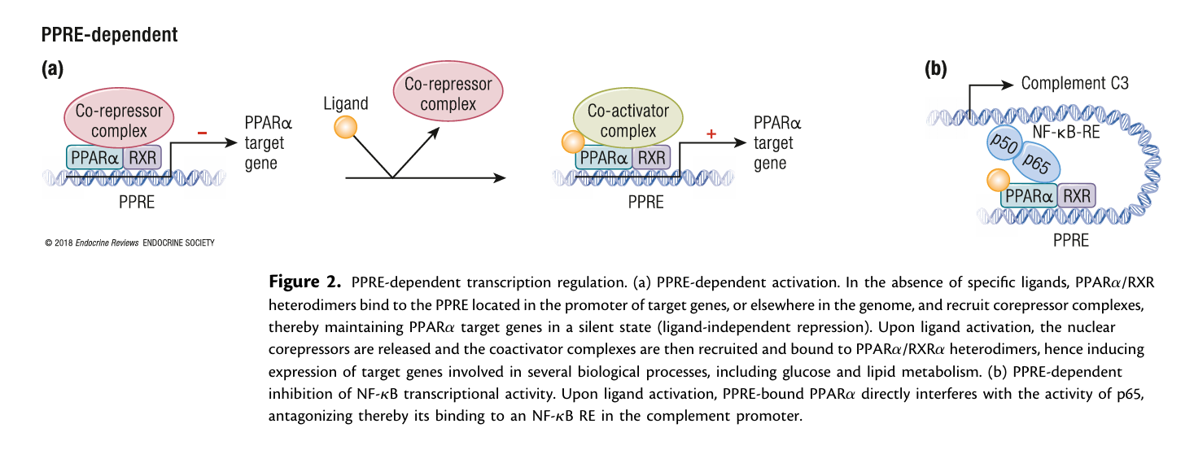
Bougarne, N., Weyers, B., Desmet, S. J., Deckers, J., Ray, D. W., Staels, B., & De Bosscher, K. (2018). Molecular actions of PPARα in lipid metabolism and inflammation. Endocrine Reviews, *39*(5), 760–802. https://doi.org/10.1210/er.2018-00064

Slide 17
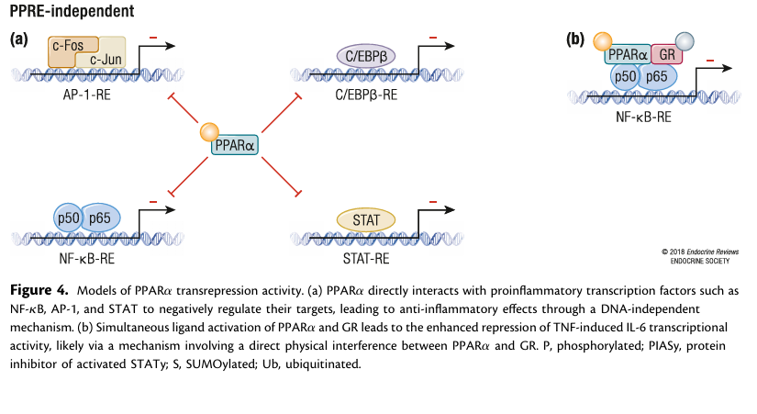
Bougarne, N., Weyers, B., Desmet, S. J., Deckers, J., Ray, D. W., Staels, B., & De Bosscher, K. (2018). Molecular actions of PPARα in lipid metabolism and inflammation. Endocrine Reviews, *39*(5), 760–802. https://doi.org/10.1210/er.2018-00064

Slide 18
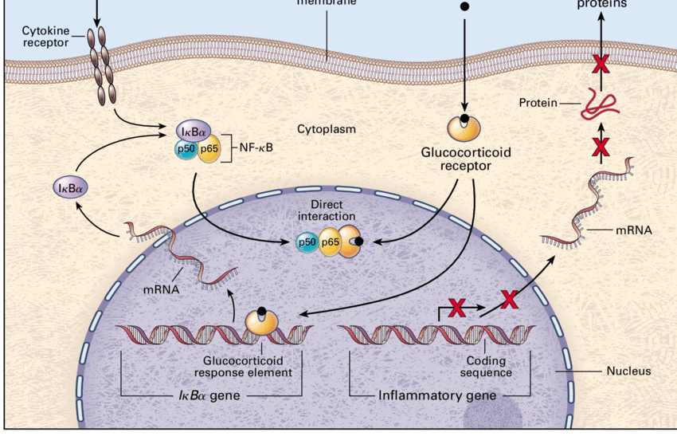
Barnes, Peter & Karin, Michael. (1997). Nuclear Factor-κB — A Pivotal Transcription Factor in Chronic Inflammatory Diseases. The New England journal of medicine. 336. 1066-71. 10.1056/NEJM199704103361506.

Slide 19
PPARα and GR converge at multiple levels to reinforce anti-inflammatory and metabolic regulation:
1. GR Regulation of PPARα Expression:
GR directly upregulates PPARα transcription in hepatocytes, aligning PPARα expression with the diurnal rhythm of circulating glucocorticoids and stress responses.
Cross-Talk with the Glucocorticoid Receptor (GR)
Bougarne, N., Weyers, B., Desmet, S. J., Deckers, J., Ray, D. W., Staels, B., & De Bosscher, K. (2018). Molecular actions of PPARα in lipid metabolism and inflammation. Endocrine Reviews, *39*(5), 760–802. https://doi.org/10.1210/er.2018-00064

Slide 20
2. Synergistic Anti-Inflammatory Action Both receptors suppress NF-κB signaling: o GR interferes physically with p65 and recruits HDACs to inflammatory promoters (tightening the DNA and turning the gene off). o PPARα promotes IκBα expression and competes for limited coactivators (inhibiting transcription).
When activated together, they exert synergistic repression of NF-κB target genes (e.g., MCP-1, IL-6), likely through direct protein-protein interactions.
Cross-Talk with the Glucocorticoid Receptor (GR)
Bougarne, N., Weyers, B., Desmet, S. J., Deckers, J., Ray, D. W., Staels, B., & De Bosscher, K. (2018). Molecular actions of PPARα in lipid metabolism and inflammation. Endocrine Reviews, *39*(5), 760–802. https://doi.org/10.1210/er.2018-00064

Slide 21
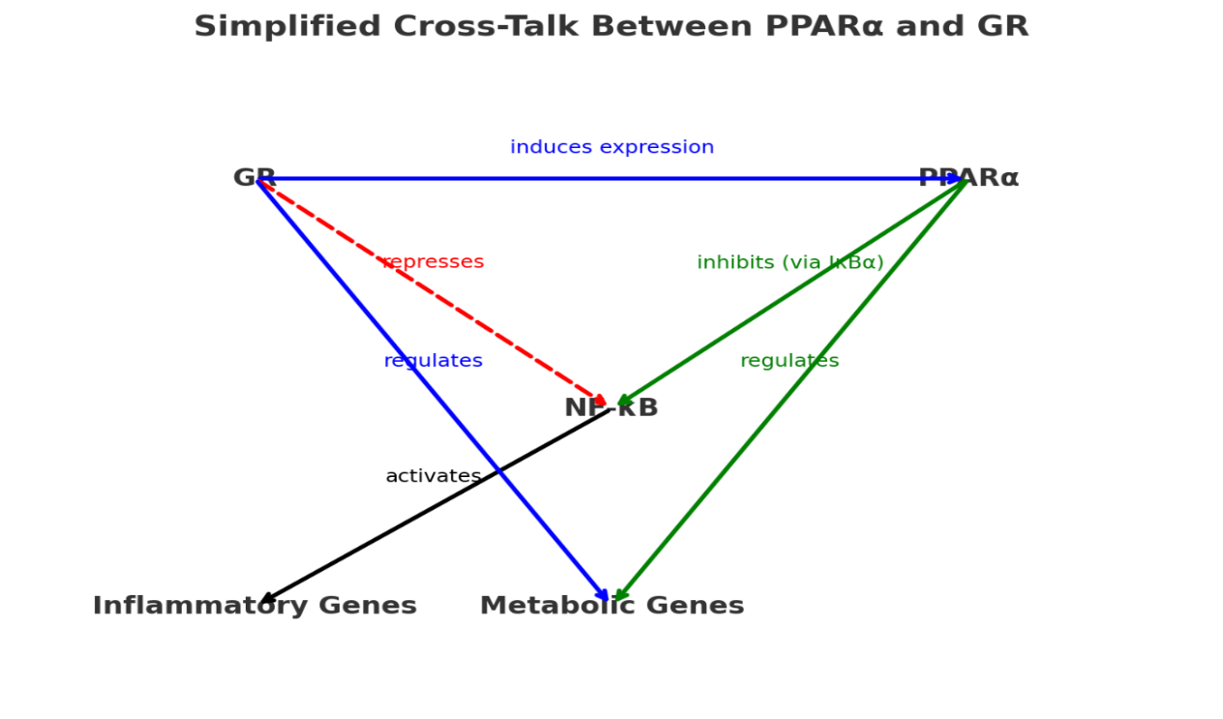

Slide 22
Why This Is a Big Deal?
Understanding this partnership opens exciting new possibilities for medicine, especially for treating chronic inflammatory diseases like asthma, rheumatoid arthritis, or inflammatory bowel disease.
•The Problem with "Crisis Manager" (GR) Alone: Using steroid drugs (which activate GR) is very effective but has severe side effects like weight gain, diabetes, and bone thinning when used long-term.
•The Potential Solution: Combining a lower, safer dose of a steroid (GR activator) with a PPARα-activating drug could be much more effective than either drug alone.
Therapeutic Implications

Slide 23
to use PEA to reduce the dose of a glucocorticoid the most appropriate and justifiable choice is Prednisolone.
💡 Rational
Glucocorticoid | Rationale for Use | Rationale Against Use / Considerations
Prednisolone | “Gold Standard” Oral GC Active Form (no liver conversion) Extensive precedent in rat arthritis models Classic broad-spectrum anti-inflammatory GC (GR-p65 interference, HDAC recruitment) | None noted
Dexamethasone | High potency & specificity (pure GR agonist) Well-defined dosing with low doses | - Less clinically relevant for chronic RA - May overpower system, masking subtle synergistic effects of PEA

Slide 24
Justification:
Clinical Relevance: this thesis aims to solve a real-world clinical problem (GC side effects).
Experimental Reliability: Using the active form (prednisolone) eliminates potential variability in liver metabolism that you'd get with prednisone, leading to cleaner and more reproducible results.
Mechanistic Alignment: It effectively engages the GR-mediated anti-inflammatory pathways (like NF-κB repression) that are central to the proposed cross-talk with PPARα.
💡 Rational

Slide 25
Study design
Aspect | Proposed Protocol
Animal Model | Adjuvant-Induced Arthritis (AIA) in rats
Experimental Groups | 1. Healthy controls (no arthritis) 2. Arthritic, untreated 3. Arthritic + effective dose of Prednisolone 4. Arthritic + sub-therapeutic dose of Prednisolone 5. Arthritic + PEA alone 6. Key Group: Arthritic + sub-therapeutic prednisone + PEA
Treatment Duration | Begin treatment after disease onset (e.g., day 21-25 post-immunization) and continue for 3-4 weeks to assess chronic effects
PEA Formulation | Ultramicronized PEA (um-PEA). Ultramicronization enhances bioavailability and efficacy compared to non-micronized forms

Slide 26
Compound | Suggested Dose (I.P.) | Basis of the Suggestion & Evidence Gaps
Prednisolone | 2-3 mg/kg (Effective Dose) | Based on a 2025 study with 10 mg/kg (oral) fully effective dose. IP dose adjusted for oral bioavailability (~70%). No direct IP RA dose found.
Prednisolone | 0.5-1 mg/kg (Low/Sub-therapeutic Dose) | Based on same 2025 study where 5 mg/kg (oral) half-dose effective in combination therapy. Supports dose-reduction goal.
PEA | 10-30 mg/kg | No specific IP RA dose found. Conservative estimate from typical experimental dosing. Pilot study recommended.
Morvaridi A, Abtahi Froushani SM, Farshid AA. Benefits of combining piperine with prednisolone in an experimental model of rheumatoid arthritis. Vet Res Forum. 2025;16(2):117-124. doi: 10.30466/vrf.2024.2031860.4316. Epub 2025 Feb 15. PMID: 40099241; PMCID: PMC11910975.
Balaji S, Woodward TJ, Richter E, Chang A, Otiz R, Kulkarni PP, et al. Palmitoylethanolamide causes dose-dependent changes in brain function and the lipidome. Front Neurosci. 2024;18:1506352.

Slide 27
Clinical Disease Scoring: Monitor and score paw swelling, erythema, and joint deformation several times weekly using a standardized arthritis index.
Histopathological Analysis: After sacrifice, process joint tissues for histology. Stains like Hematoxylin & Eosin (H&E) and Safranin O can evaluate synovitis, pannus formation, cartilage erosion, and bone destruction
Molecular Biomarkers: Analyze serum, synovial fluid, or joint tissue homogenates for:
Pro-inflammatory Cytokines: TNF-α, IL-1β, IL-6, and PGE₂ via ELISA, which are known to be suppressed by PEA .
🔬 Key Outcome Measures and Biomarkers

Slide 28
Protein Expression Analysis: Use Western Blot or Immunohistochemistry on joint tissue lysates to measure:
NF-κB Pathway: Phosphorylation of IκBα and nuclear translocation of p65.
Anti-inflammatory Target: Total IκBα protein levels, which PPARα is known to upregulate
Gene Expression Analysis: RT-qPCR on joint tissue to examine the expression of genes downstream of NF-κB (e.g., Tnf-α, Il-6) and GR.
Receptor Localization: immunohistochemistry to visualize the cellular co-localization of PPARα and GR in the synovium of treated animals, which could support a direct protein-protein interaction.
🧬 Molecular Analysis to Investigate Synergy

Slide 29
Immunoadjuvant (e.g., Complete Freund's Adjuvant, CFA) to induce arthritis.
Clinical Scoring Supplies: Basic calipers for measuring paw thickness and swelling.
🐀 Kits for the RA Animal Model

Slide 30
🔬 Kits for Mechanism and Efficacy Analysis
Research Area | Required Kits & Reagents | Key Measurements
Molecular Mechanism | PPARα Reporter Assay Kit | PPARα activation by PEA
 | ELISA Kits for IkBα & p65 | NF-κB pathway protein levels (phospho-IkBα, nuclear p65)
Inflammation Assessment | ELISA Kits for IL-6, TNF-α, MCP-1 | Inflammatory cytokine levels in serum/joint tissue

Slide 31
Test Compounds: Prednisolone and Palmitoylethanolamine (PEA), both prepared in suitable vehicles for intraperitoneal injection.
Animal Injection Supplies: Appropriate syringes and needles.
Sample Collection Tubes: For collecting and processing blood (serum/plasma) and tissue samples.
🧪 General Laboratory Supplies

